Slide 1
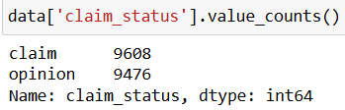
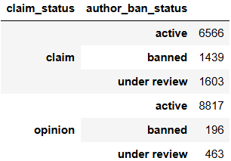
Executive Summary: Data Preparation
Tiktok Claims Classifcation Project
The TikTok data team seeks to develop a machine learning model to assist in the classification of claims for user videos. First, TikTok’s provided data needs to be examined to prepare for the process of exploratory data analysis (EDA).
The data team performed a preliminary investigation of the classification dataset to discover important relationships between variables.
Specifically, for each category of claims and opinions, the data team looked at their respective number of videos, author ban status, and average video view, like, share, and comment count.
The counts of each claim status are quite balanced, with 9,608 claims and 9,476 opinions.
To understand the impact of user videos, the data team identified several variables to consider, namely counter variables such as video_view_count, video_like_count, video_share_count, and video_comment_count, and additional engagement metrics such as likes_per_view, shares_per_view, and comments_per_view.
The mean and median view count for both video categories show an association between content type and video counts.
Mean view count claims: 501029.4527477102
Median view count claims: 501555.0
Mean view count opinions: 4956.43224989447
Median view count opinions: 4953.0
The author ban status count for each claim status represents a tendency for videos of banned authors to represent claims rather than opinions.

